Slide 1
How to book Vevo-2100 and USB Key Ying Li MPC, 2024

Slide 2
1. Book your Vevo-2100 experiment online https://resource.cores.utah.edu/#/home

Slide 3
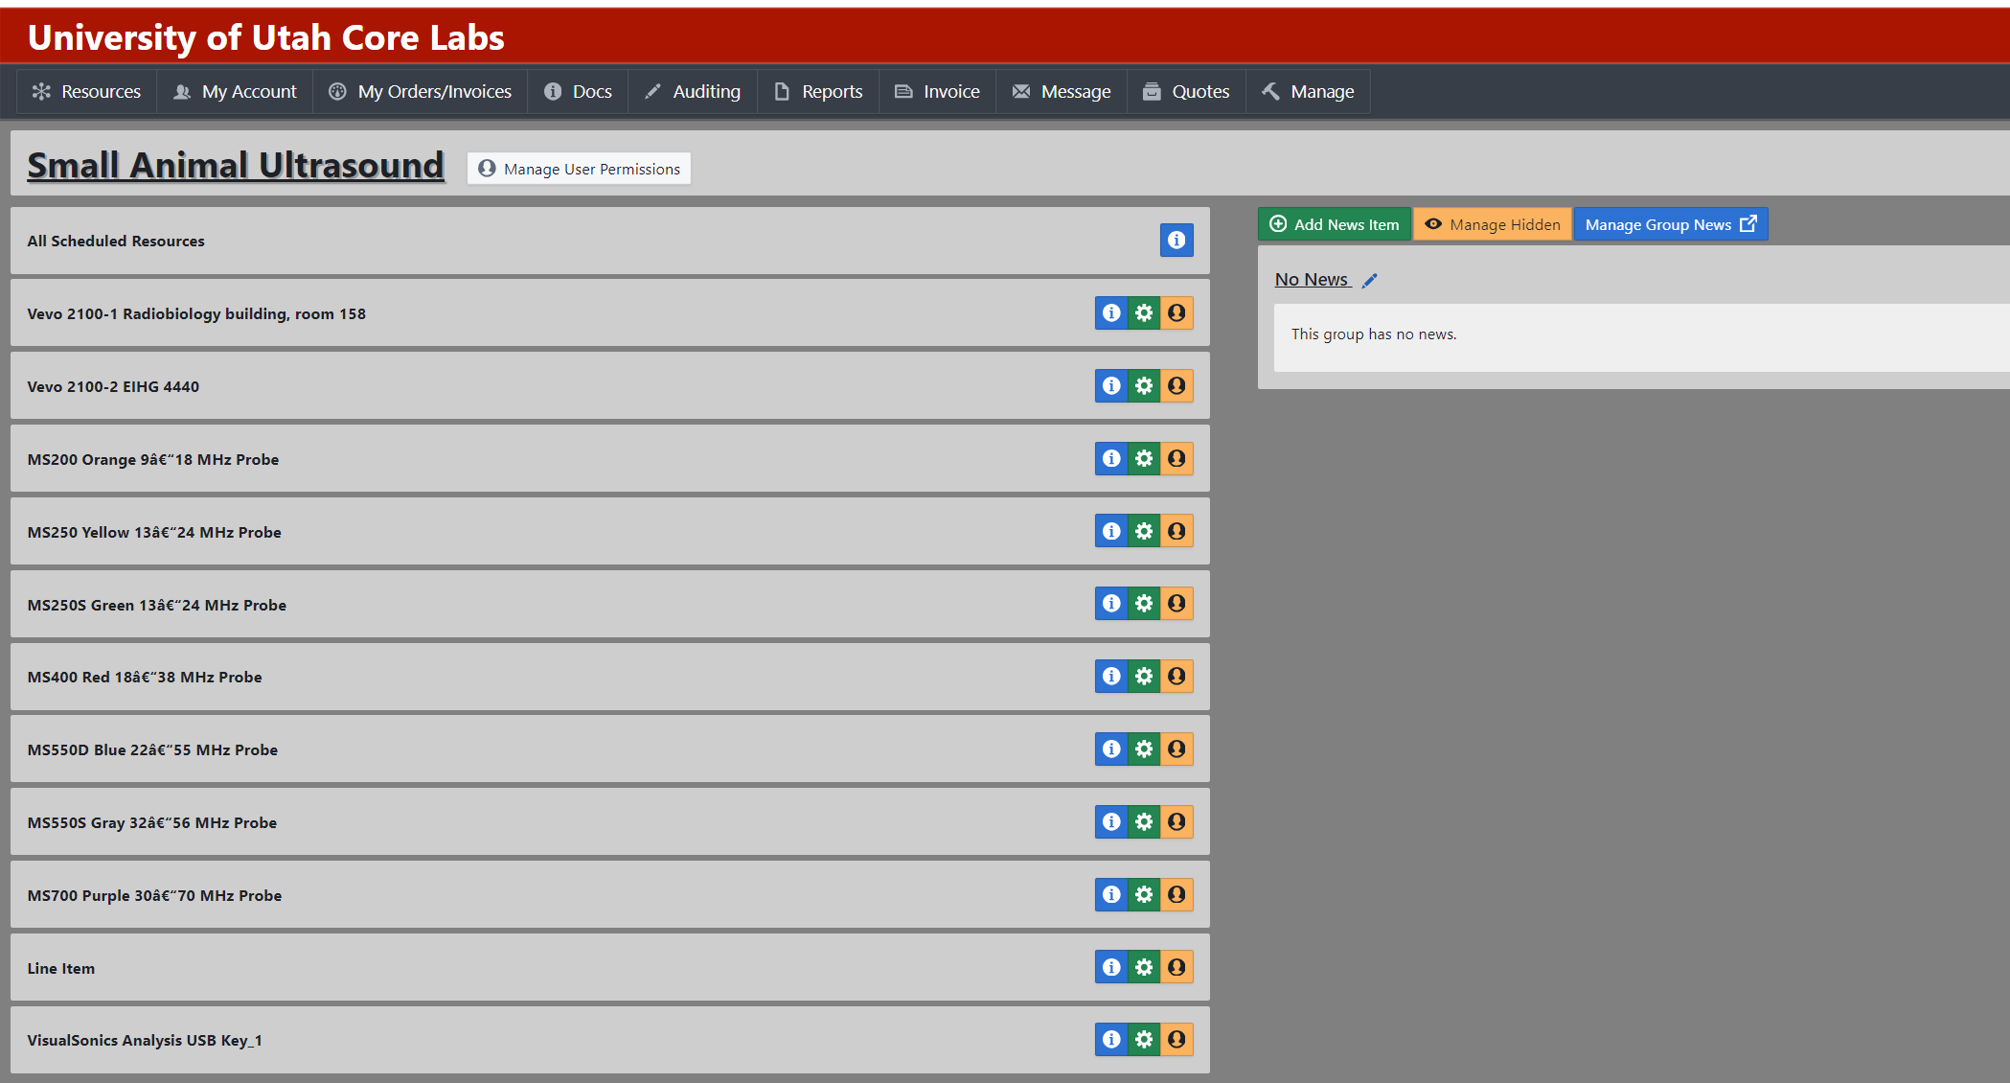
2. Select the time slot you plan to do the experiment
* CVRTI has a USB key; Users from other departments can book your USB key online.

Slide 4
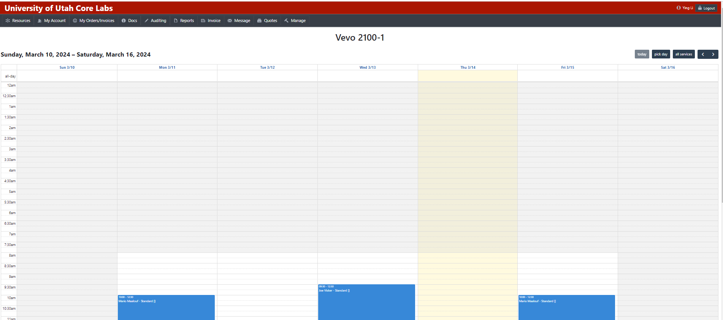
3. Select the time slot you plan to do the experiment

Slide 5
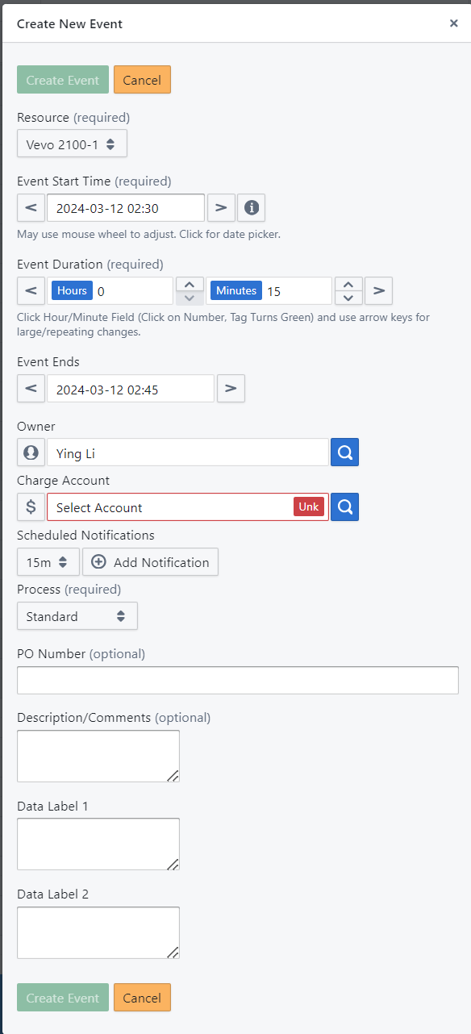
4. Type in your information and schedule an event

Slide 6
5. New users can set up a meeting with Ying to get a training;
5. Take the mice to the core and measure their body weight;
6. Conduct the experiment and save your data.

