Slide 1
How to book Seahorse and prepare an experiment Ying Li MPC, 2024

Slide 2
1. Book your Seahorse experiment online https://resource.cores.utah.edu/#/home

Slide 3
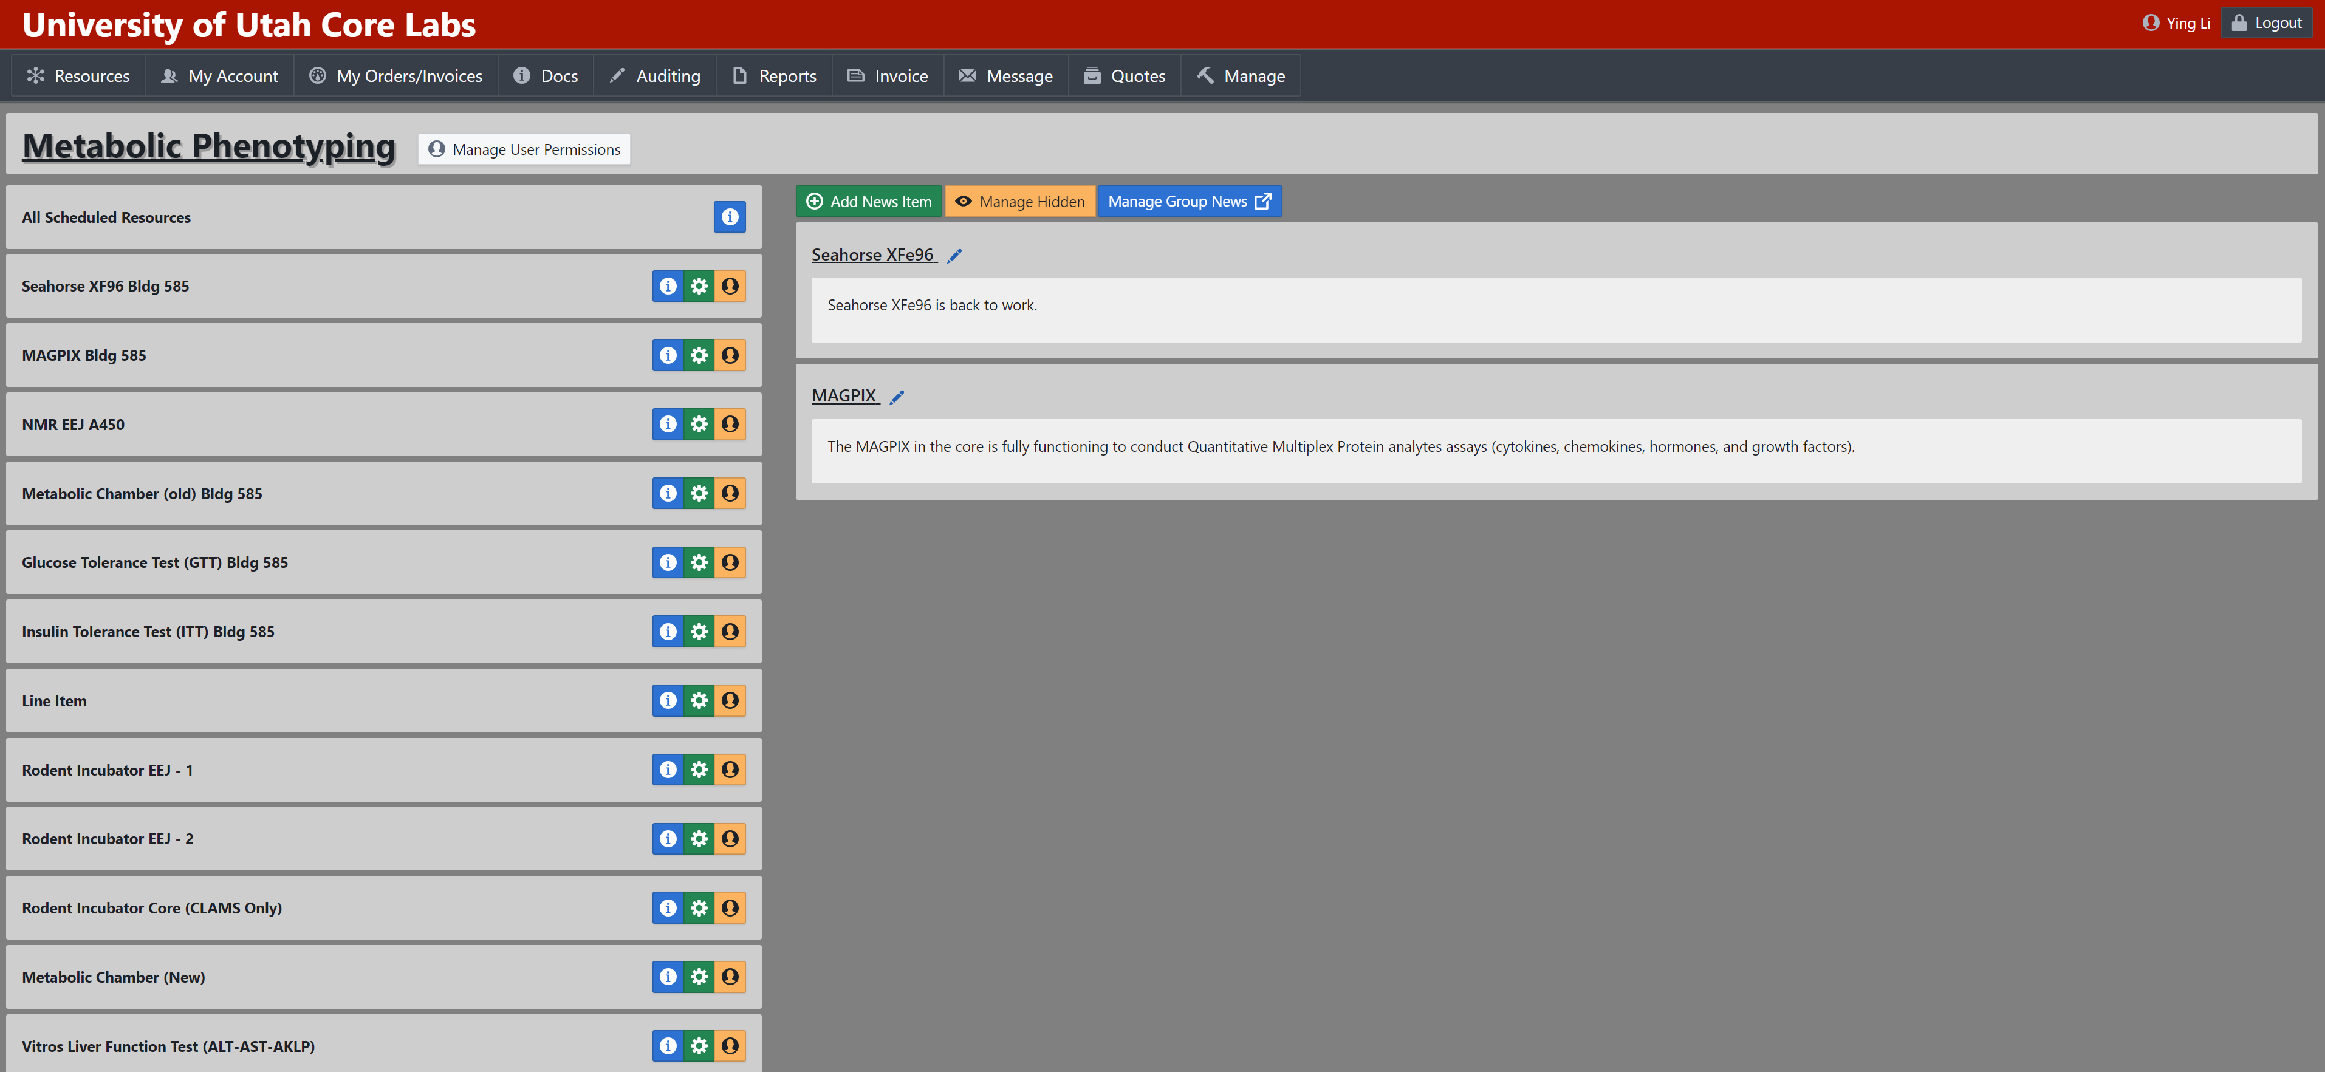
2. Choose the time slot you plan to do the experiment

Slide 4
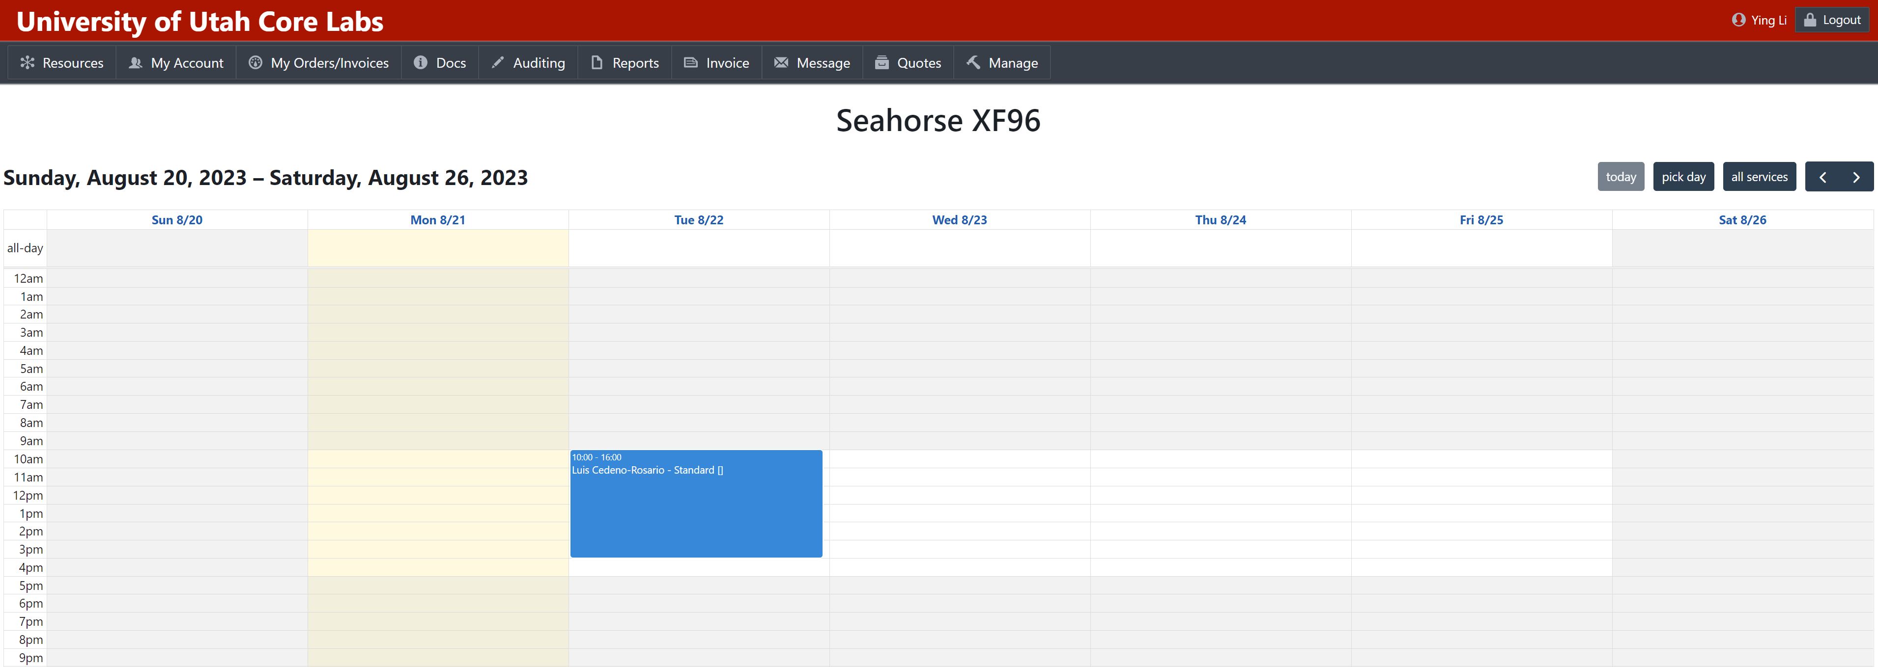
3. Choose the time slot you plan to do the experiment

Slide 5
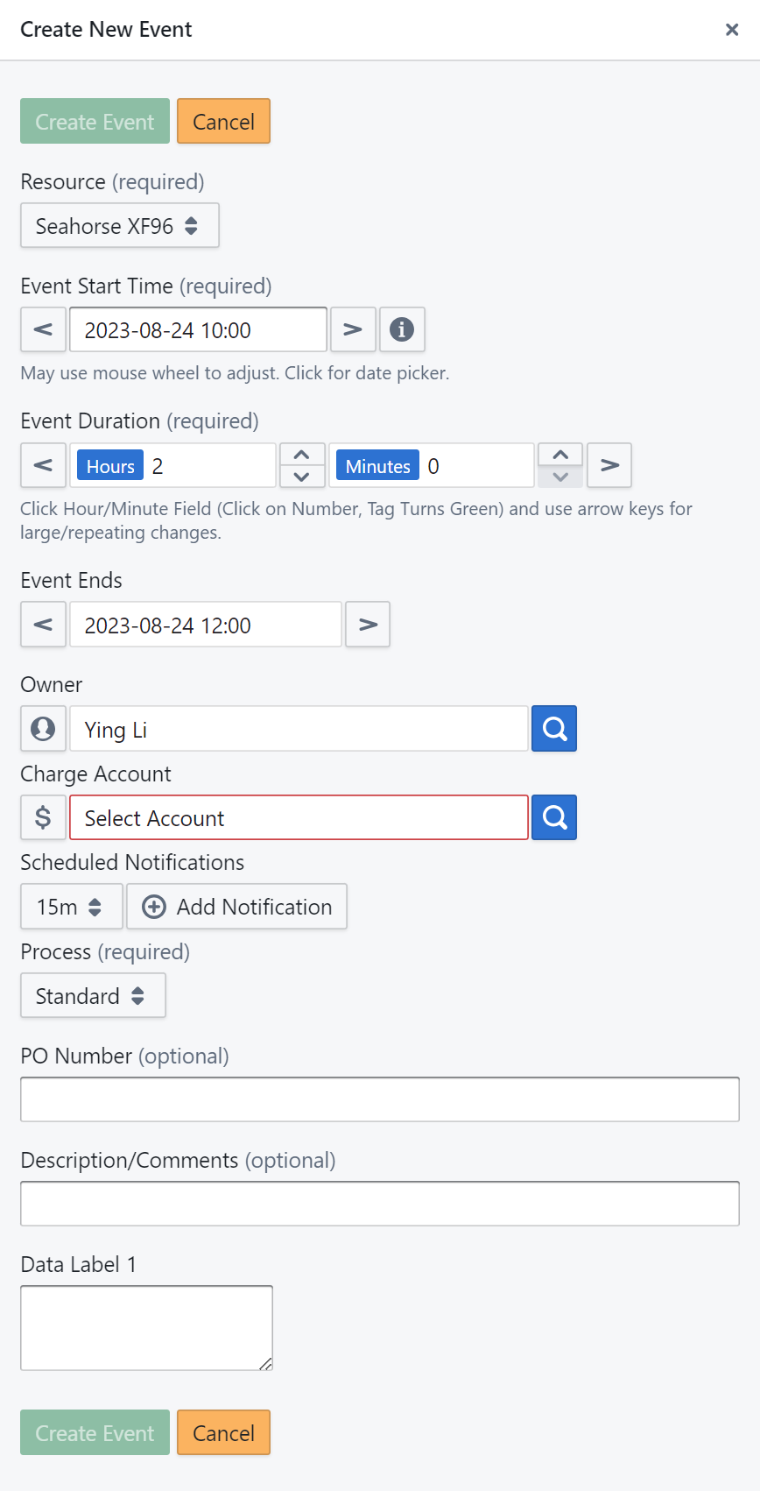
4. Type in you information and schedule an event
A standard Seahorse test typically lasts around 2 hours. If you require more time, please reserve 4 hours or longer. Our billing is based on the number of plates used, not on hours.

Slide 6
5. Reach out to MPC and complete the layout template.
Contacts: Xue.yin@hsc.Utah.edu; li.ying@hsc.Utah.edu
6. New users are welcome to arrange a meeting with Ying to discuss experiment specifics.
7. Obtain a plate and medium (optional) from the core facility and prepare your cells in the Seahorse-specific plate.
8. Deliver the plate to the core facility half an hour before the scheduled time.
9. Retrieve the plate approximately 2 hours later for BCA analysis to normalize the data.

Slide 7
10. Online resources for the Seahorse experiments
Publication Database: https://www.agilent.com/search/?N=4294836537&Ntt=seahorse
Manuals for Analysis: https://www.agilent.com/search/?N=4294950063&Ntt=seahorse

