Slide 1
How to book NMR (Bruker LF50) and prepare an experiment Ying Li MPC, 2024

Slide 2
1. Book your NMR online https://resource.cores.utah.edu/#/home

Slide 3
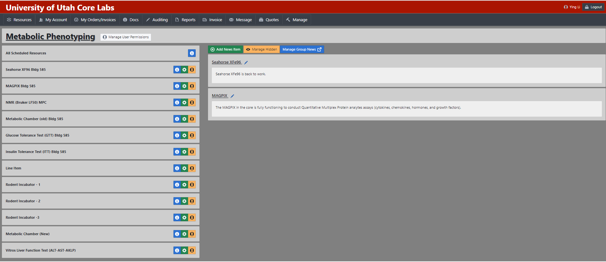
2. Choose the slot you plan to do the experiment

Slide 4
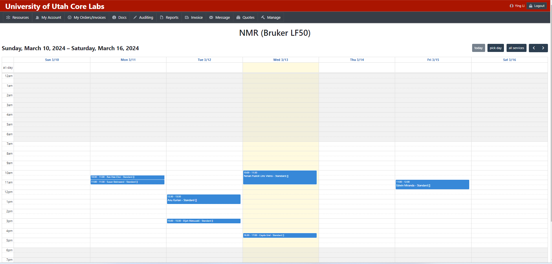
3. Choose the slot you plan to do the experiment

Slide 5
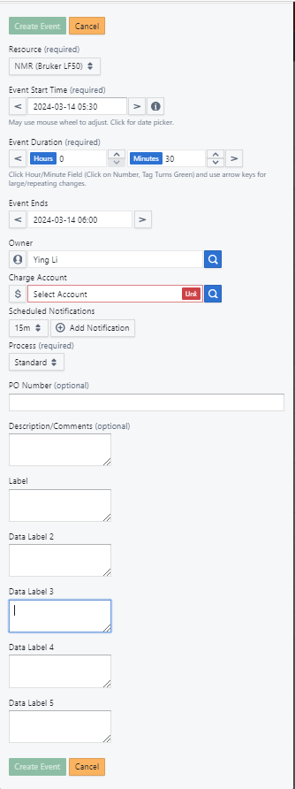
4. Type in you information and schedule an event

Slide 6
5. New users have the option to schedule a training session with Ying.
6. Transport the mice to the core facility and record their body weights.
7. Carry out the experiment and ensure to save your data.

