Slide 1
How to book CLAMS and prepare an experiment Ying Li MPC, 2024

Slide 2
1. Book your CLAMS experiment online https://resource.cores.utah.edu/#/home

Slide 3
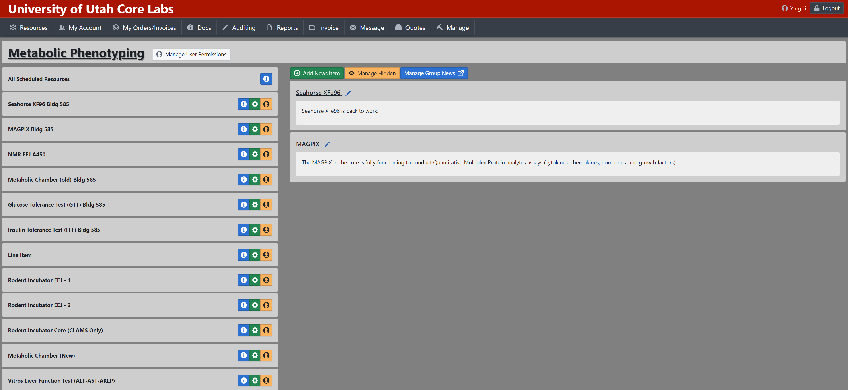
2. Choose the slot you plan to do the experiment
* If you want to control the temperature (cold exposure or thermoneutrality) or use different light cycle, please choose “Metabolic Chamber (old)”. Otherwise, please choose “Metabolic Chamber (New)”.

Slide 4
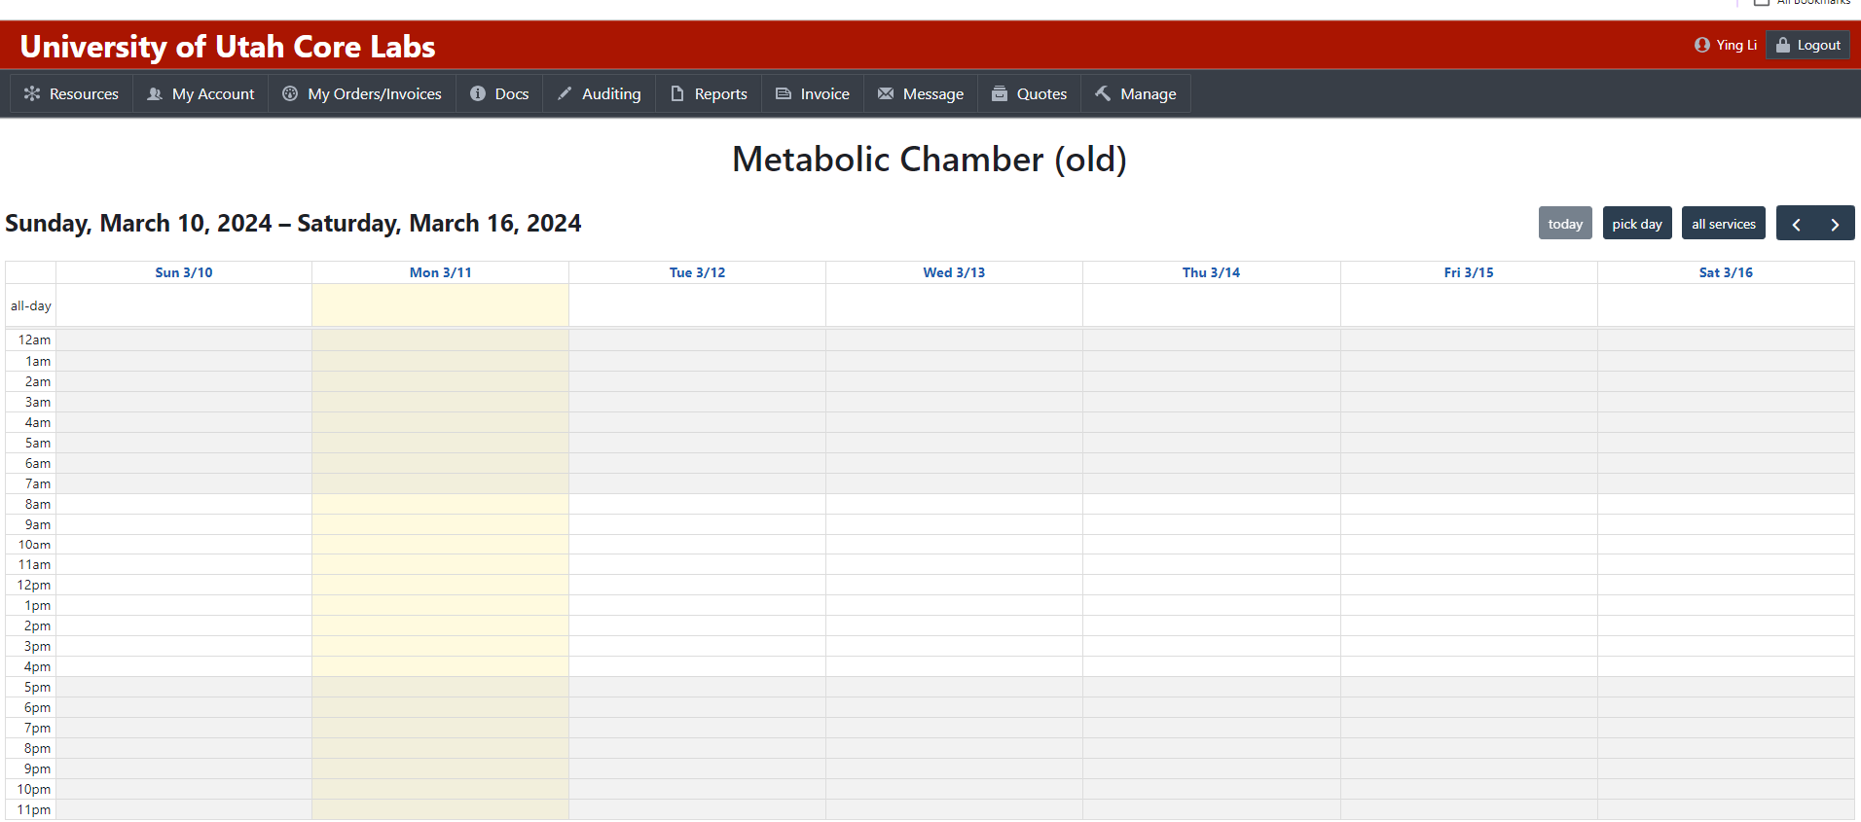
3. Choose the slot you plan to do the experiment

Slide 5
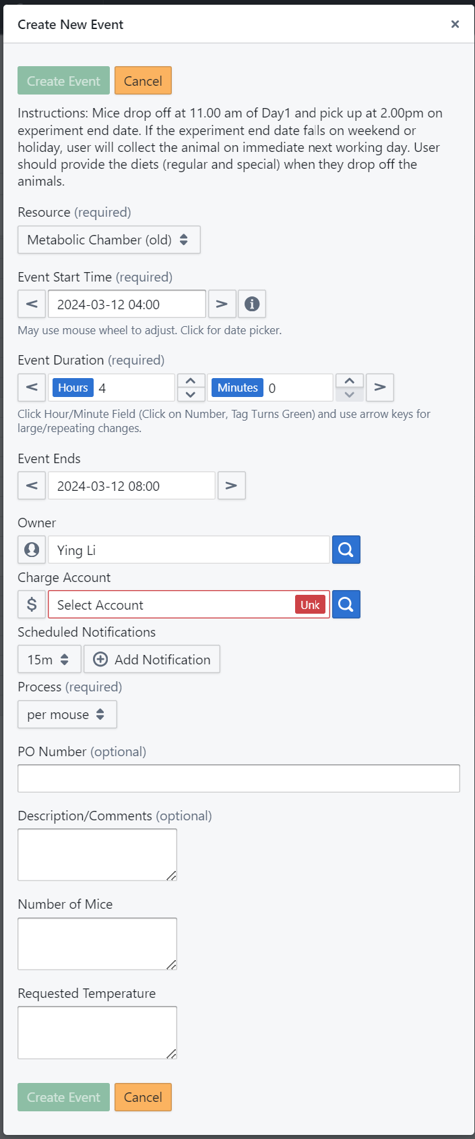
4. Type in you information and schedule an event
We suggest a minimum of three days for acclimation, as it typically takes the mouse approximately one to one and a half days to adjust to the new environment.

Slide 6
5. Bring the mice and their diet to MPC around 10 am on the scheduled day.
6. Weigh and tail mark the mice upon arrival.
7. Complete a form with detailed information about the mice.
8. Conduct body composition measurements.
9. Return to collect the mice approximately 3 to 4 days later, ideally between 12 to 1 pm.
10. Perform another round of body composition measurements.
11. Transfer and organize the collected data for analysis.

Slide 7
12. CLAMS data analysis software suite
CLAX download: Free software from Columbus Instruments.
https://www.columbusinstruments.com/downloads/
CalR: Free online software.
https://calrapp.org/

